Slide 1
MITgcm code and documentation repo updates
Jean-Michel Campin, Jeff Scott, Ed Doddridge, Oliver Jahn, Chris Hill
Main activities
Migrating from own server CVS to hosted git ( at github.com )
Migrating from own server .tex for documentation to hosted “github, .rst + sphinx/readthedocs pipeline”
Migrating code browser to LXR
Web site new skin

Slide 2
MITgcm CVS to git
Test setup is at
https://github.com/altMITgcm/MITgcm
Mostly follows pre-existing directory structure except documentation is now within the same directory tree (and in a different format – see later)
Currently testing pull request (PR) workflows for both code and documentation
4 people with github PR accept auth (Jean-Michel, Oliver, Chris, Ed)
2 approvals required to merge
Travis rudimentary automated testing
HowTo guide here http://mitgcm-example.readthedocs.io/en/latest/contributing/contributing.html - work in progress, feedback/questions happily incorporated – please send.
Note - path names (github.com/altMITgcm/MITgcm and mitgcm-example.readthedocs.io ) are intermediate. Things will ultimately migrate to github.com/MITgcm/MITgcm and mitgcm.readthedocs.io

Slide 3
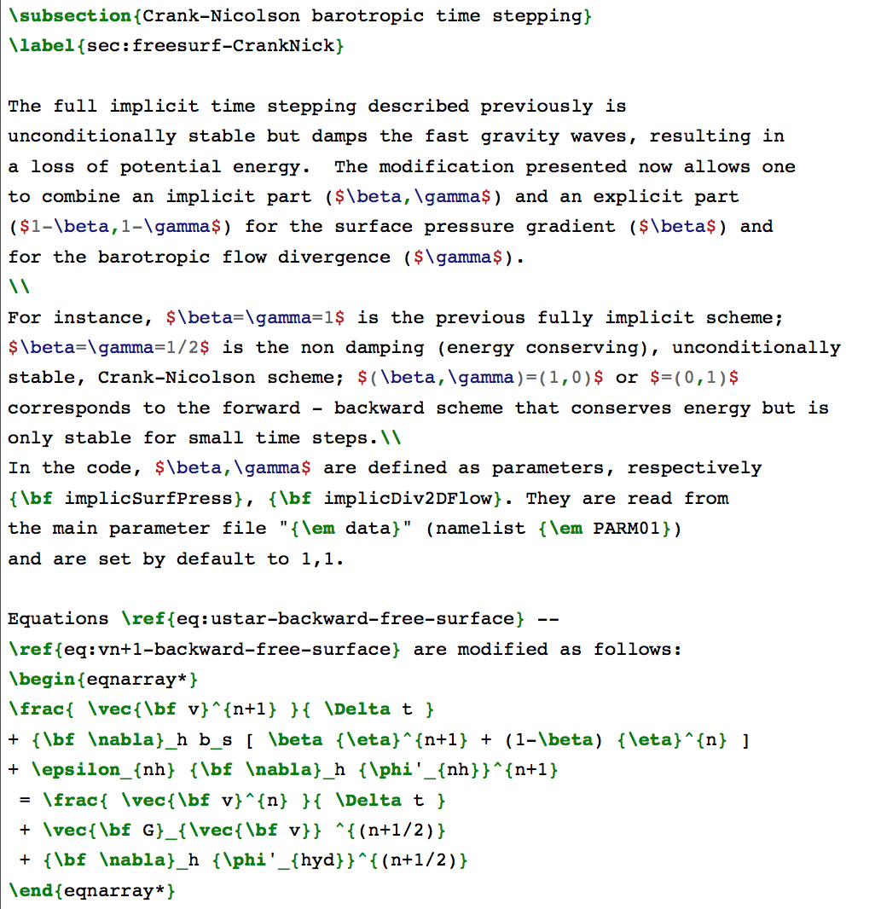
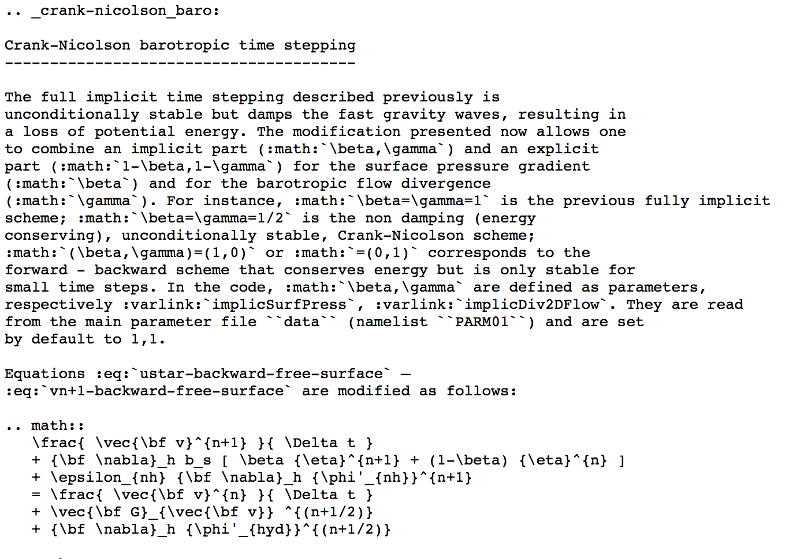
MITgcm latex to rst
Jeff Scott and Ed Doddridge have been converting Part 1 of manual to .rst
Current state is at http://mitgcm-example.readthedocs.io/en
First pass automated using pandoc, then needs subsequent hand clean-up (Jeff has experience)
.rst uses mostly same math syntax as latex – but not identical e.g.
http://wwwcvs.mitgcm.org/viewvc/MITgcm/manual/s_algorithm/text/time_stepping.tex?revision=1.34&view=markup
https://raw.githubusercontent.com/altMITgcm/MITgcm/master/doc/discret_algorithm/crank-nicol.rst

Slide 4
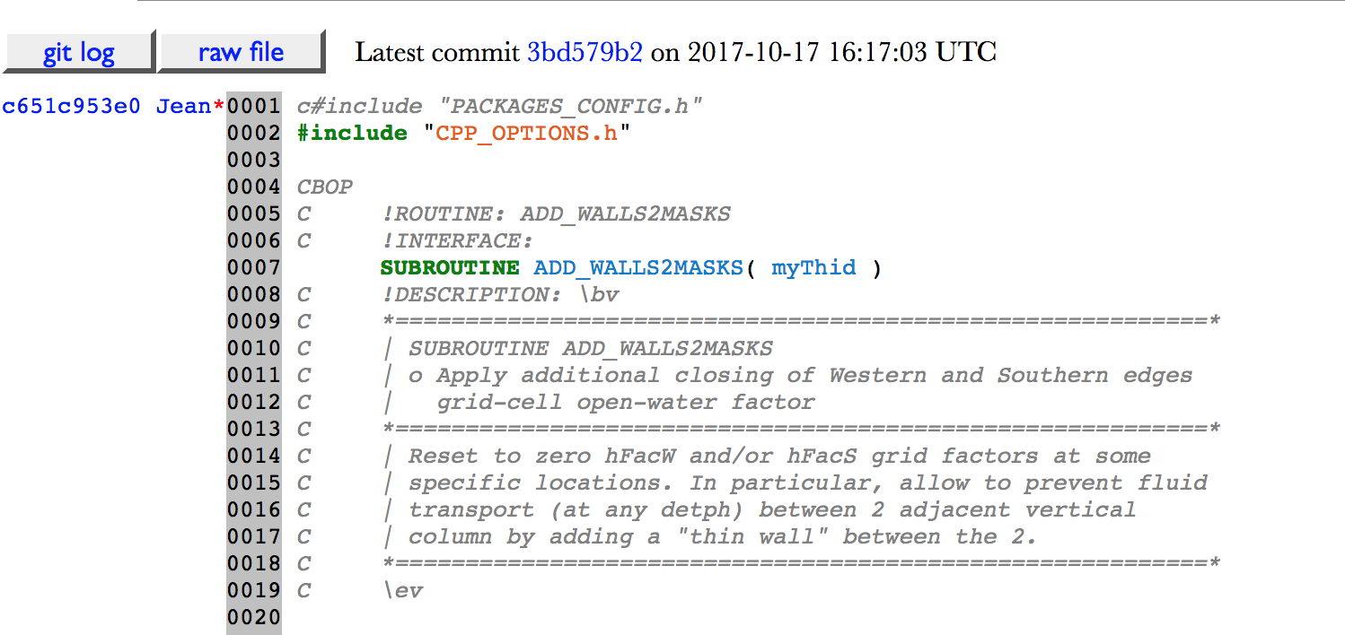
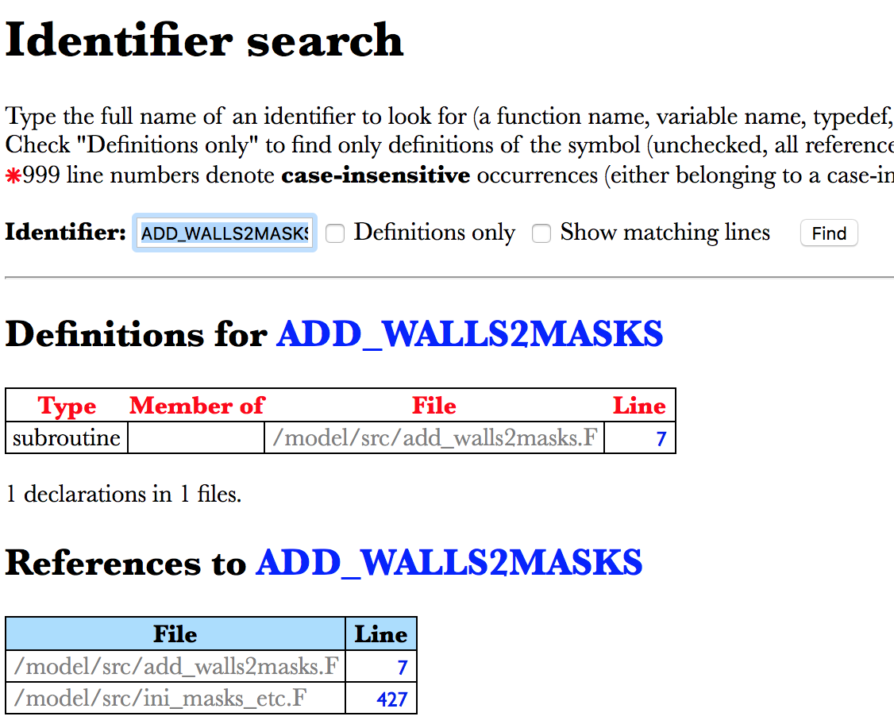
Code browser to lxr (with a few fortran customizations!)
e.g. http://lxr.mitgcm.org/lxr2/source/MITgcm/model/src/add_walls2masks.F
Provides most of same name look up and occurrence capabilities.
Temporarily hosted on Raspberry Pi (?) so a bit slow.

Slide 5
Web site new skin

Slide 6
~Timeline
CVS MITgcm/ and manual/ freeze and production git switch
Hopefully in next few weeks.
New .rst documentation will not be complete, but is a long way along. Looking for contributions
MITgcm_contrib/ staying under CVS for now
LXR will migrate to faster server and storage to hopefully speed up queries like http://lxr.mitgcm.org/lxr2/ident/MITgcm?_i=myThid
New web site skin demos shortly after MITgcm/ and manual/ to final github locations.
Mailing list and support archives are staying under local mailman.
Maybe use Slack for github chatter!!!!

